Slide 1
Lander University
End User Training
Nov.
5,
2025

Slide 2
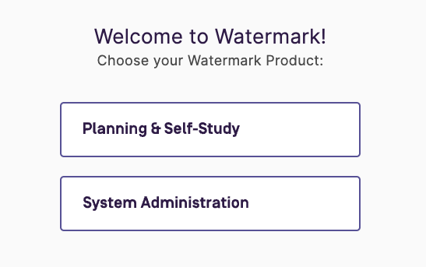

Housekeeping & Log In
Housekeeping:
There will be a Q&A at the end of the session
You will receive this powerpoint after the session
Log in:
Step 1: Go to the MyLander page
Locate the “Teach/Advise” section and find “Watermark”
Step 2: Once you are on the Watermark selection page Click on Planning and Self-Study (PSS).
Please note that it may require you to sign in using our Single Sign On.
You may also use this link to log in:
https://login.watermarkinsights.com/connect/landeruniversity
Tips for Logging In
Use Google Chrome
Clear your cookies and cache

Slide 3
Roles & Responsibilities in the Assessment Process
Assessment Coordinator:
Serve as the “Lead” for their designated Academic Program
Communicate with the Dean about goals/outcomes
Responsible for completing and submitting the annual assessment plans
Vice Presidents:
Not assigned as “Leads”, but has access to view all designated programs
Responsible for reviewing each annual assessment plan after submission
*This training will show you what the Assessment Coordinators will see and do in Watermark.

Slide 4



Watermark Team Introductions
Dr. Alex Lejarza
Senior Product Consultant

Slide 5

Planning & Self Study: Training Overview
Navigating the Home Page
Organization Management
Plans

Slide 6
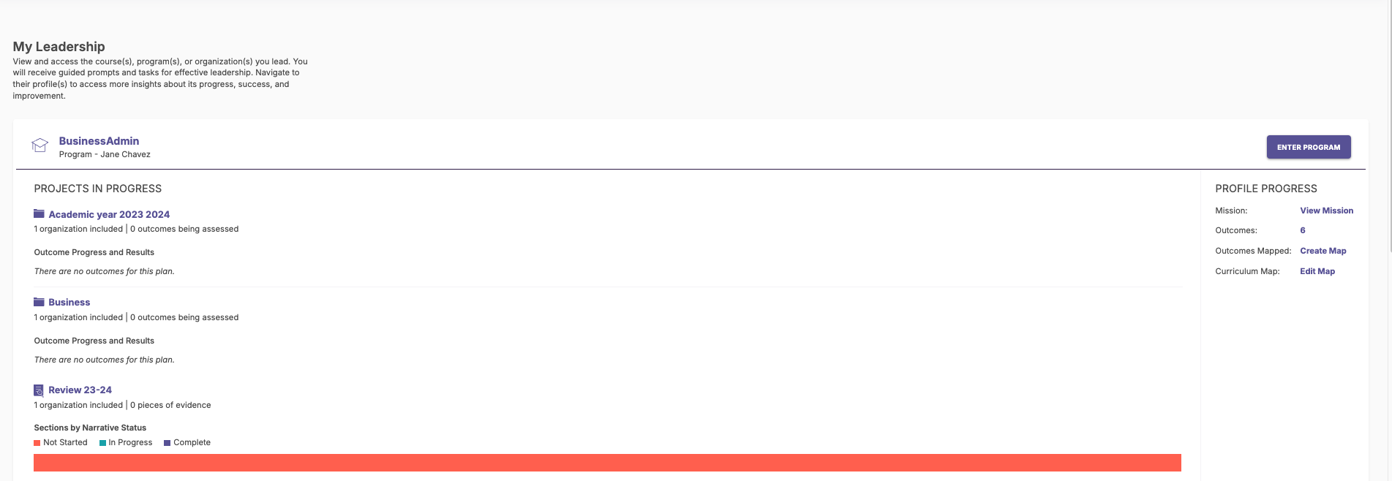
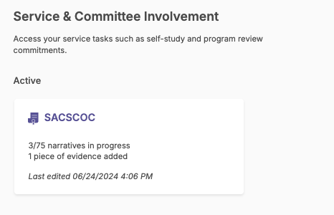
Welcome to Your Assessment Lead Home Page!
As a lead of a program; you may see the following in your system.
My leadership: Showcases each area (e.g. program) where you are placed as a lead, with links to any projects and charts showing their progress.
Enter Program/Profile Progress: allows quick links to all items in the program.
Service & committee involvement: Calls your attention to tasks related to self-studies and program reviews.

Slide 7

Organization Management
Building the foundation of your system

Slide 8
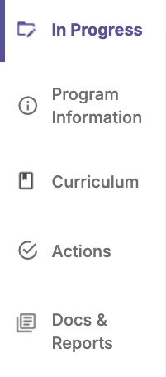

Building Your Foundation in P&SS (Lead View)
Projects In Progress - Access, monitor and track your program’s projects that are active and in progress
Communicate the purpose and design of your organization or program through creation of a mission statement, outcomes and measures
Access and edit the curriculum map. View courses affiliated with this organization.
Review proposed Actions from assessment plans and provide status updates to communicate progress.
Add documents and access reports to track continuous improvement and organizational activity.

Slide 9
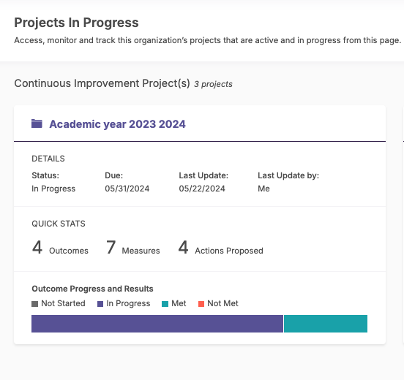
In Progress Tab
If a Project is open, it will be listed here, and the user can click on its name to access it.
*Note - if a Plan has been closed, a report containing its data can be located under the Docs & Reports tab.

Slide 10

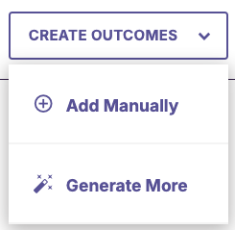

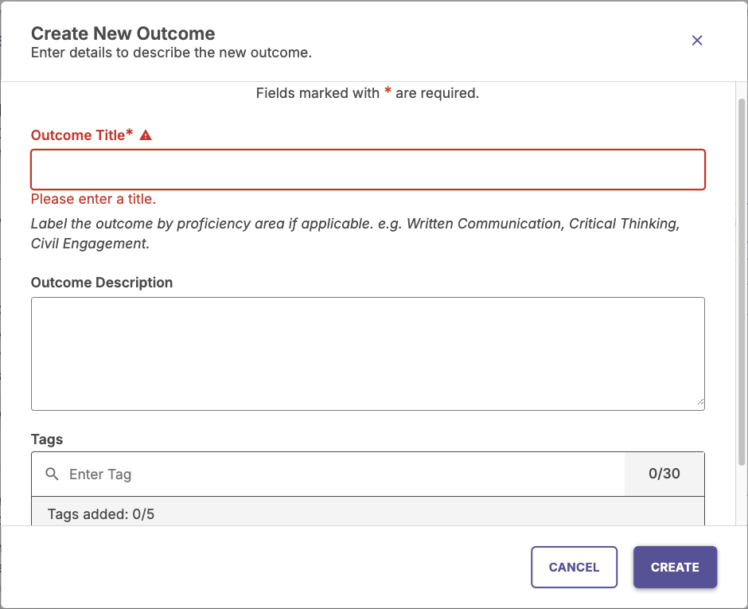
Program Information Tab: Learning Outcomes
Once in the Program ; you will click on Program Information.
You will find the Outcomes section below Mission Statement.
Click on “MANAGE OUTCOMES”.
Select in top section “Learning Outcomes”.
Then “CREATE NEW OUTCOME”.
Outcome Title is required. You have 70 characters.
It is optional to input Outcome Description and Tags.
You are able to place Tags on Learning Outcomes only.
Once done click “CREATE”
You can now click “DONE”

Slide 11

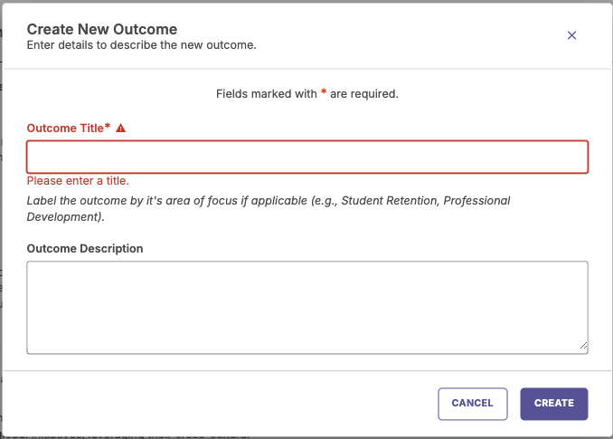
Program Information Tab: Success Outcomes
Once in the Program ; you will click on Program Information.
You will find the Outcomes section below Mission Statement.
Click on “MANAGE OUTCOMES”.
Select in top section “Success Outcome.
Then “CREATE NEW OUTCOME”.
Outcome Title is required. You have 70 characters.
It is optional to input Outcome Description and Tags.
You are unable to place Tags on Success Outcomes
Once done click “CREATE”
You can now click “DONE”

Slide 12
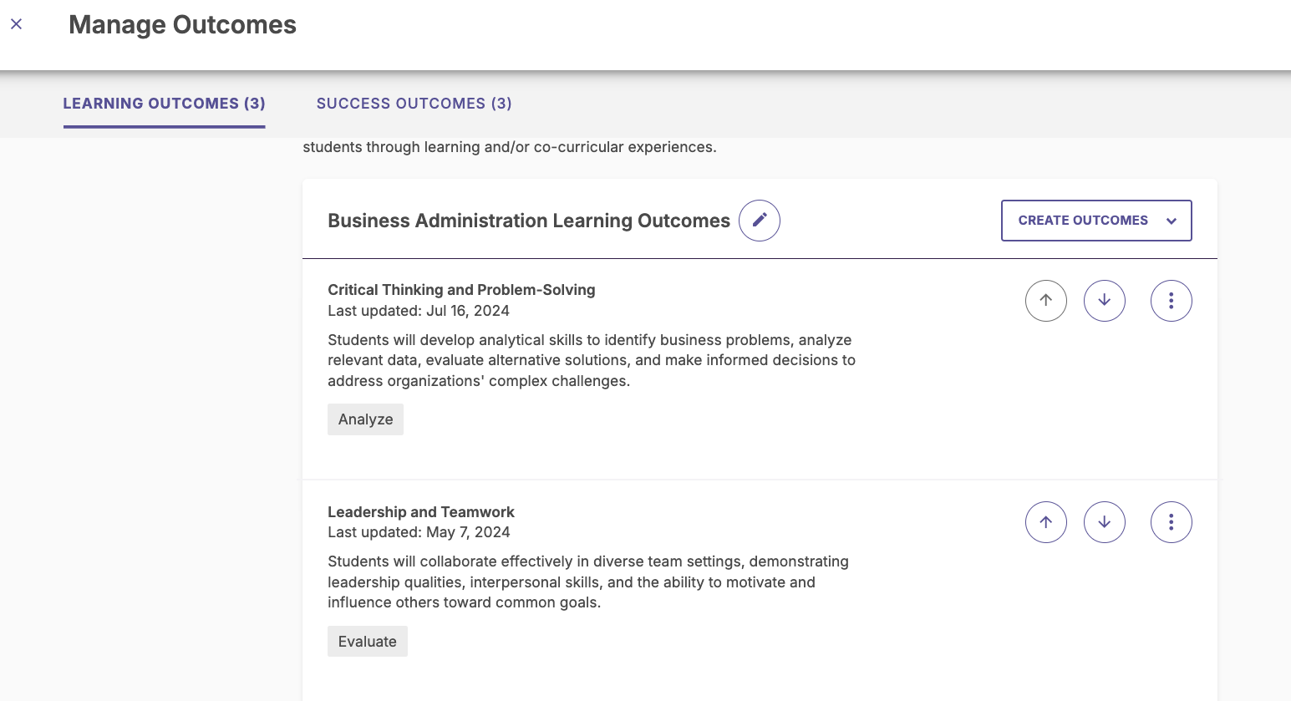
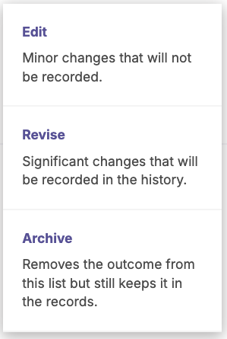
Program Information Tab: Manage Outcomes
You are able to edit Outcomes:
Click three dots icon next to the outcome and:
Edit: Used for typos, will save over the past
Revise: Use for new outcomes associated with a given year (or just create a new outcome and archive the existing one). Will save the history.
Archive: Saves the outcome for future use but removes from current lists . Will save in an “archived” list where it can be restored.
Delete: only available for outcomes with no other attachments such as maps
Up and Down arrows- move outcomes
Remember to click “DONE”

Slide 13
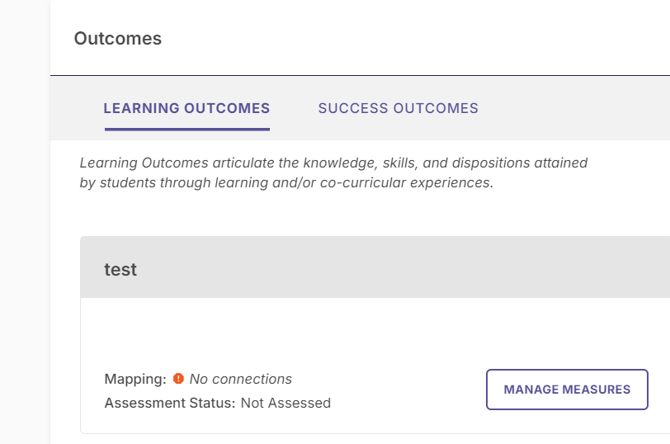
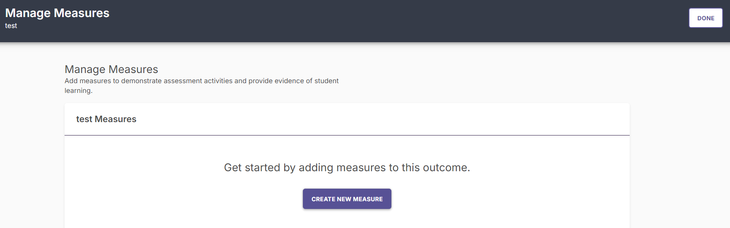
Program Information Tab: Create a Measure
Each outcome has a “Manage Measures” button
-You can create as many measures for an outcome as you need
-Click “Manage Measures, then “Create New Measure”.

Slide 14
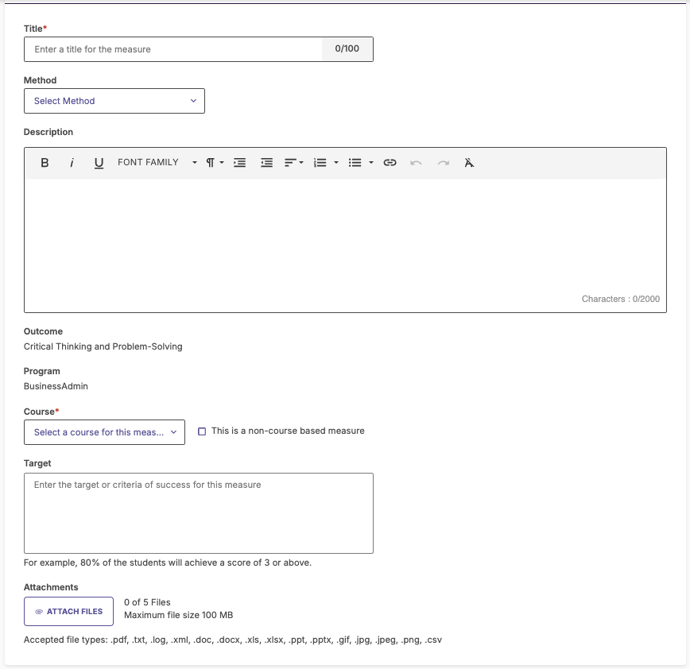
Program Information Tab: Create a Measure, Continued
Add details:
Title (required)
Method - see dropdown list
Success and Learning outcomes may have different methods.
Description
Outcome & Program are displayed
Course (if applicable)
Target
Attachments
Click “CREATE MEASURE”
Click “DONE”
When Advanced Blackboard is aligned you will have an option to align the measure (not covering today).

Slide 15
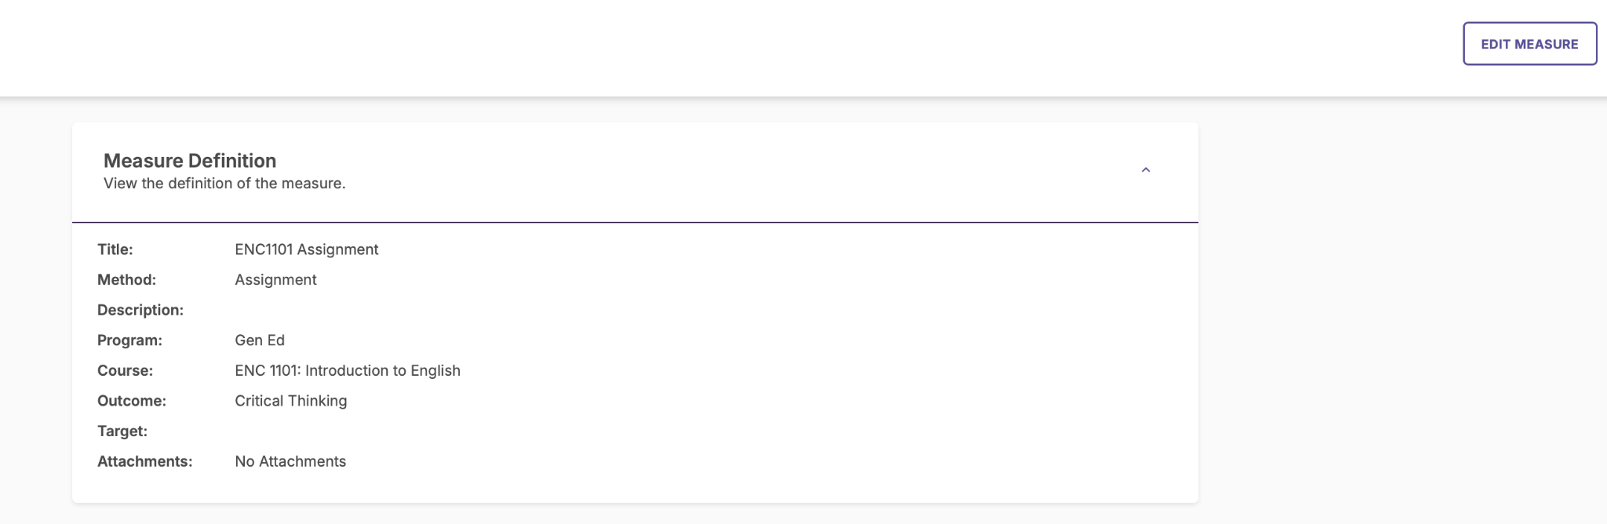
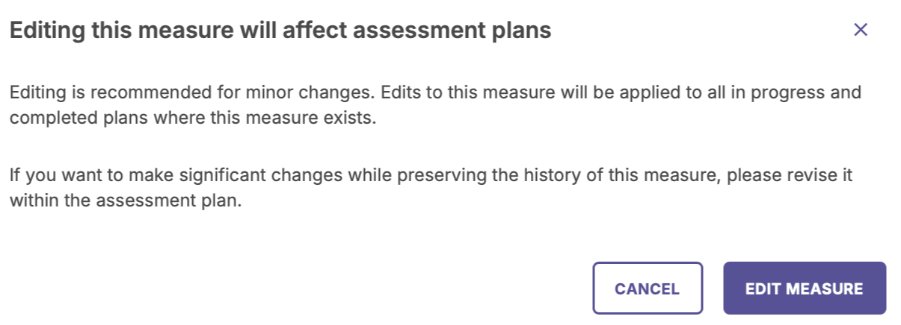
Edit an Existing Measure
To Edit an existing measures:
Click on the measure itself
At the top right, you will see an Edit option
Note! This will impact your Plans

Slide 16
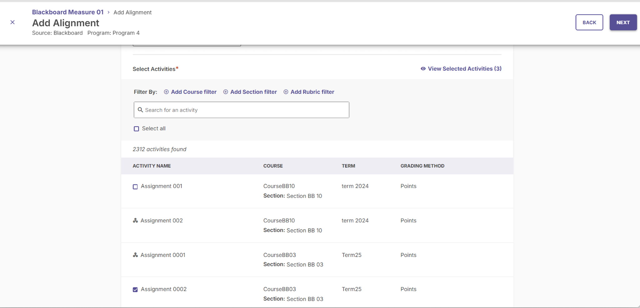
Blackboard Integration
Although you have other options to add data, you can use the Blackboard integration to pull in Activities
The following help article will walk you through the steps to create an alignment to an activity in the measure.
Note: You will need to set up the Met Criteria (the article can be found in this link). This will pull your data into the Plan.

Slide 17
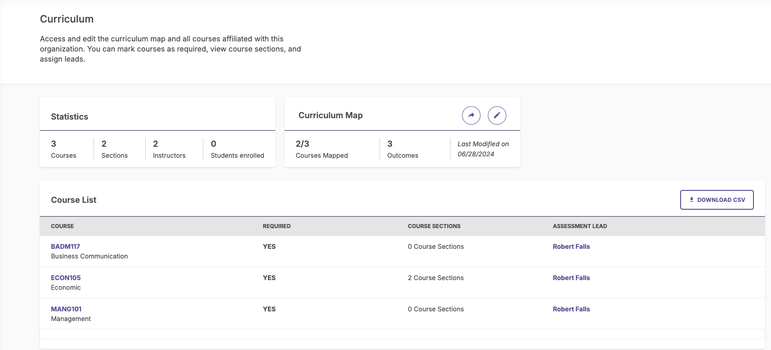
Curriculum Tab
Statistics: Reports information about total course sections, etc. associated with this organization or program.
Course List: Lists courses that can be included in a curriculum map, or included in a measure for assessment purposes
If you need courses that do not appear on your list, please talk with your Administrator.

Slide 18


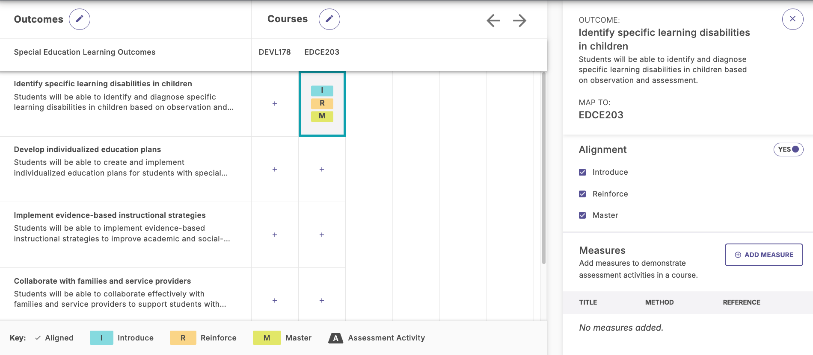



Curriculum Tab: Curriculum Maps
Click on “Create New Map” or “ ” icon to edit an existing map.
To align outcome(s) to courses, select the "+" associated with the desired outcome and Courses.
In the side panel toggle “yes” next to Aligned.Map to any specific outcomes associated with the Course that populate on this side panel.
Select the Alignment (I,R,M). If the Outcome is being used in a Plan then A (Assessment Activity) will show.
SAVE AND EXIT.
Click “ ” to share as PDF or link.

Slide 19
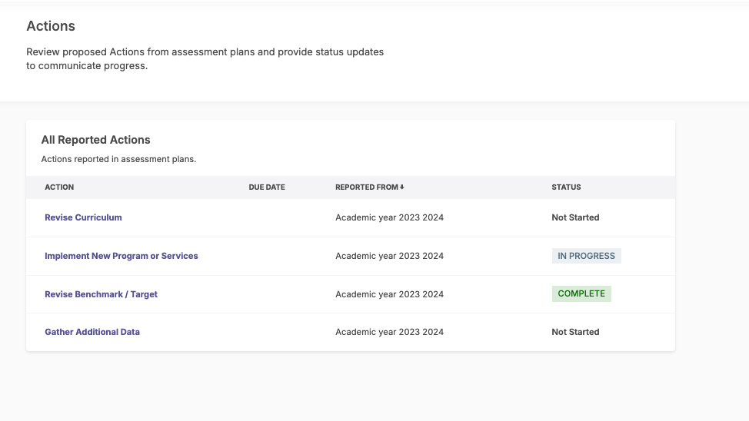
Actions Tab
Once you start participating in Assessment Plans, you will be able to add Actions.
This screen allows you to follow the status of any Actions and add updates to Actions.

Slide 20
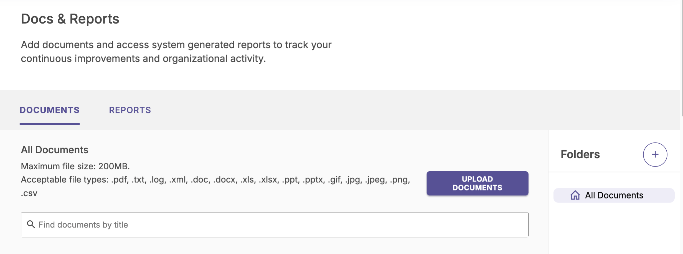
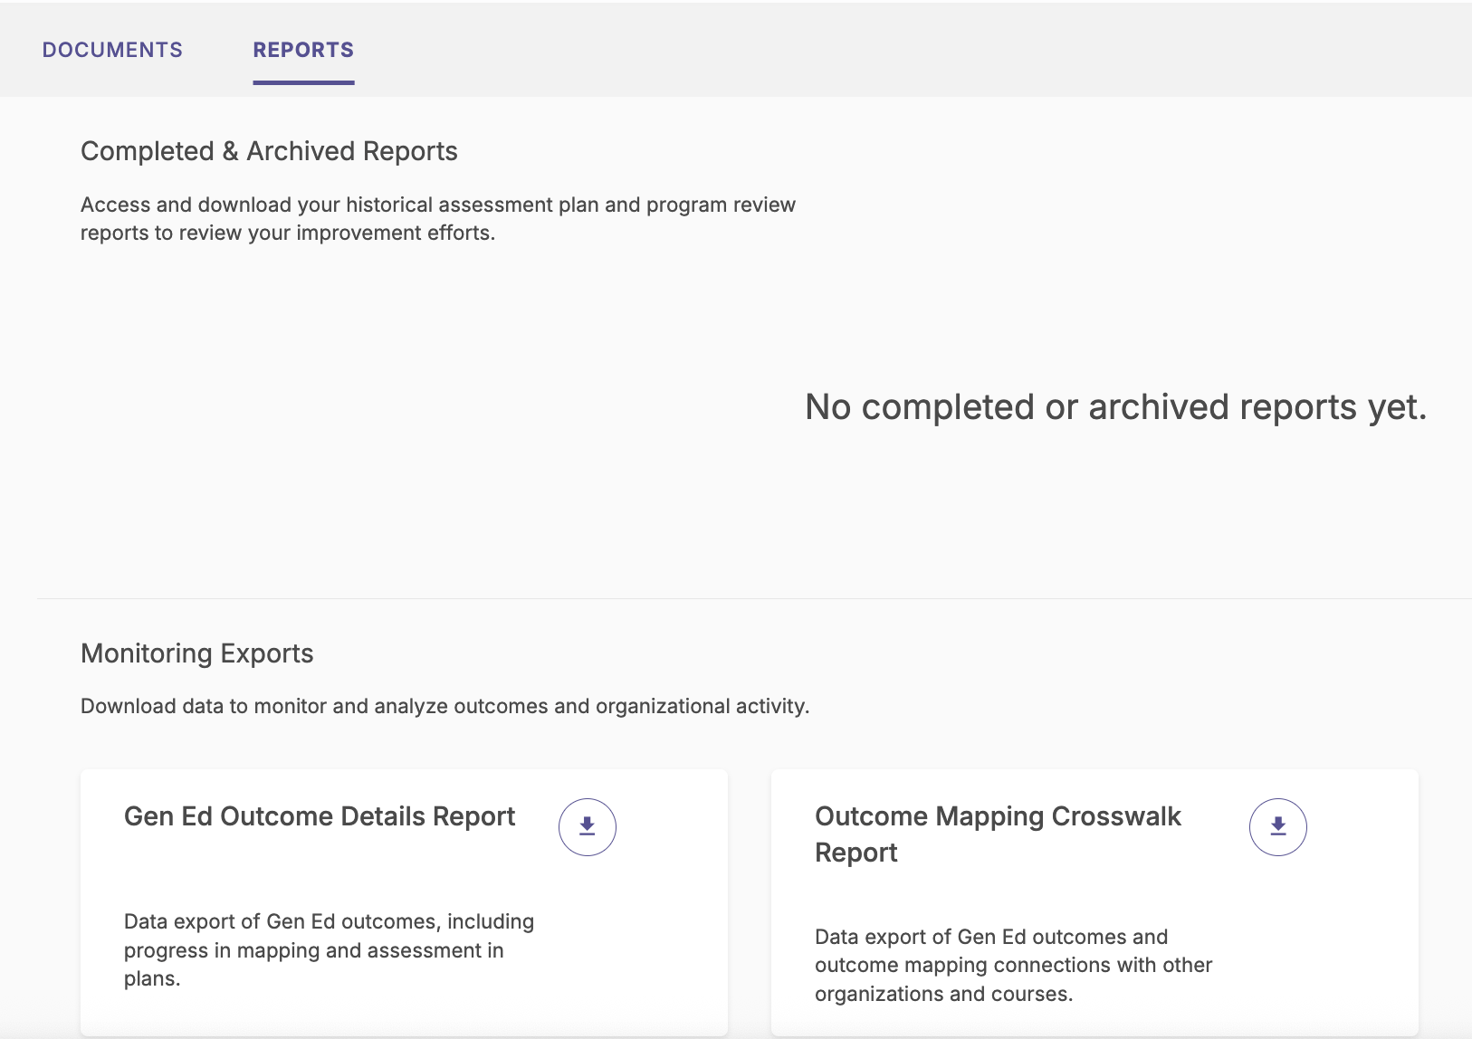
Docs & Reports Tab
3 functionalities in this area:
Access completed assessment plan and archived program reviews
Upload documents (and manage in folders)
View reports for your unit:
Outcome Detail Report
Outcome Mapping Crosswalk
If you are the Lead of an Organization over other Programs or Organizations, you can view their reports.

Slide 21

Questions about Organization Management?

Slide 22
Time to Practice!
Take the next 15 minutes to practice adding an outcome
Feel free to take a break before we navigate Plans

Slide 23

Plans
Annual plans are used to assess outcomes with measures and related data

Slide 24
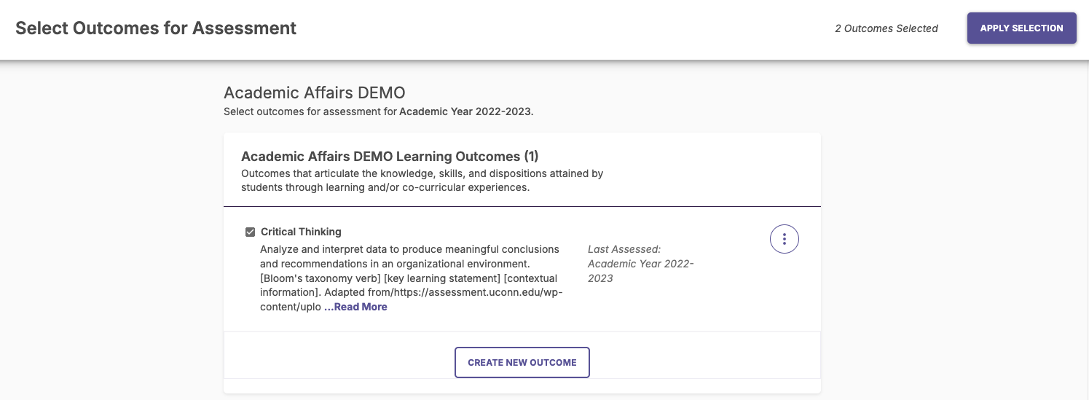
Selecting Outcome
When you are invited to participate in an Assessment Plan, you'll select via the checkbox next to the Outcomes that the Organization will assess during the Assessment Plan Reporting Year.
Adding Outcomes begins with clicking the "Select Outcomes" button upon entering the Plan.
The following page will display a list of all the Organization’s Outcomes.
If changes to an Outcome are needed, you can be made on this page.
Clicking the "3 dots" to the right of any Outcome will present the Edit options.
Selecting "Create New Outcome" at the bottom of the screen will allow you to add additional Outcomes that are required.
Do note any changes made to the Outcomes will reflect in Organization Management.
Once you have finalized your selection of Outcomes, click "Apply Selection" in the upper right-hand corner of the page.

Slide 25
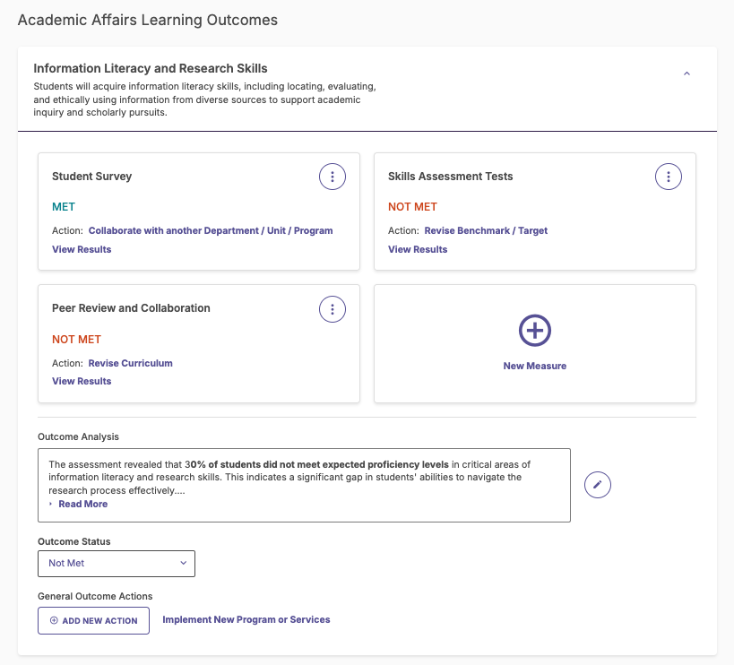
Working in an Assessment Plan
When you are invited to participate in an Assessment Plan, you can:
-Select Outcomes
-Assess Outcomes Using Measures
-Add Data to Measures
-Identify Whether Measures are Met or Not
-Identify Whether Outcomes are Met or Not
-Add Actions
-Review/Share Annual Plan .pdf Report

Slide 26




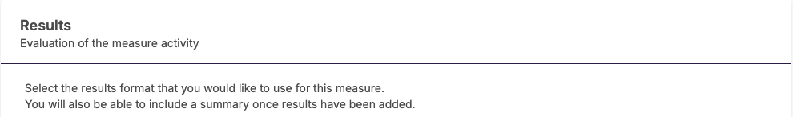
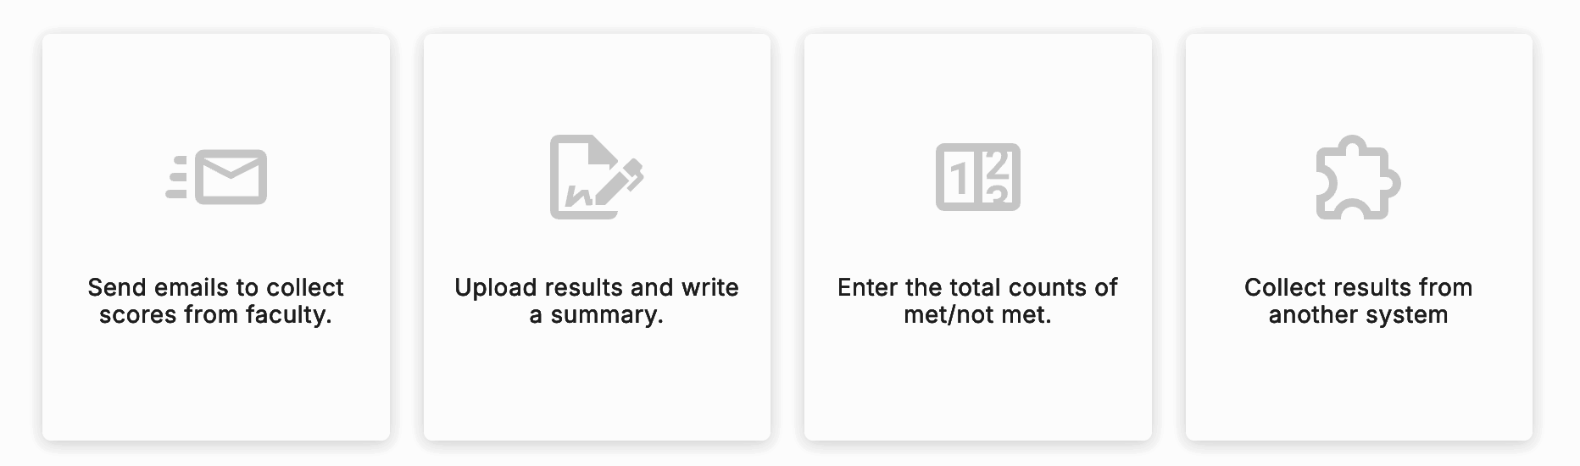
Adding Data to a Measure Within a Plan
Select your plan
Select a Measure & Click on Add Results
This includes integration with other Watermark products.
You may or may not see this option depending on files loaded. Talk to your Administrator if you have questions.

Slide 27
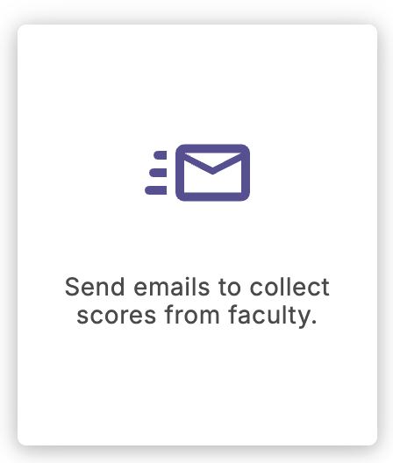
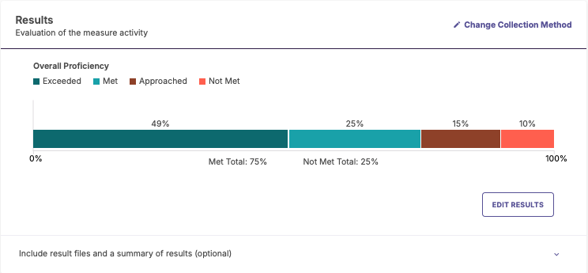
Assessment Plans: Assess Outcomes/Measures By Sending Emails to Faculty
You can send emails to faculty from Planning & Self-Study. Faculty will receive an email alerting them to input student results. The results will generate a chart for the final report.
Your System Administrator will have to ensure the proper files are loaded in the system for this method to function properly. This option may not be available in your system.

Slide 28
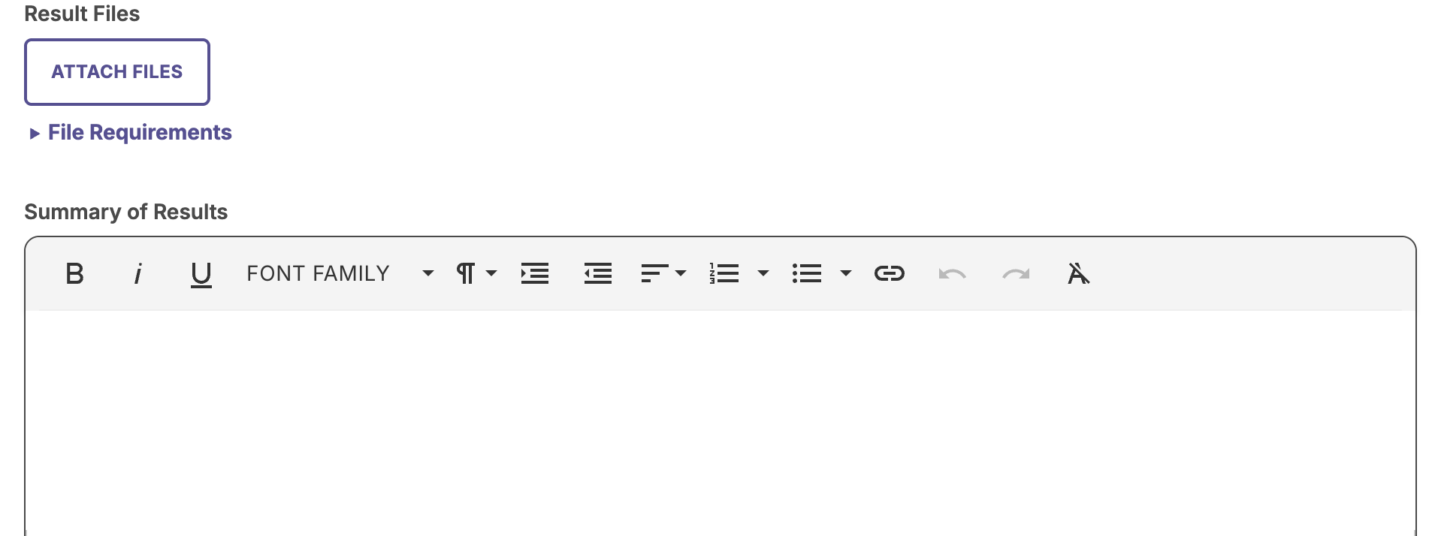

Assessment Plans: Assess Outcomes/Measures By Uploading a File
You can upload a file and also include a Summary.

Slide 29
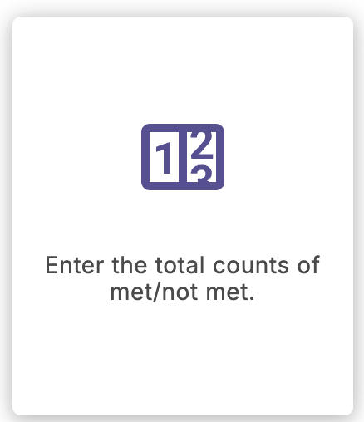
Assessment Plans: Assess Outcomes/Measures By Entering Numbers in Count Categories
You can enter numbers in count categories that will then be converted to percentages of “met” or “not met” to compare to your target for the measure.

Slide 30
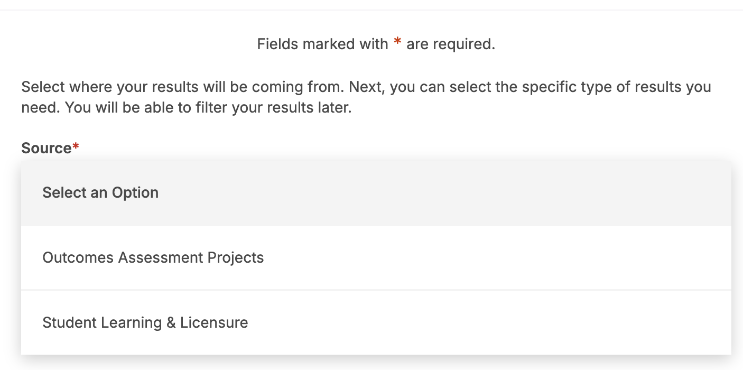
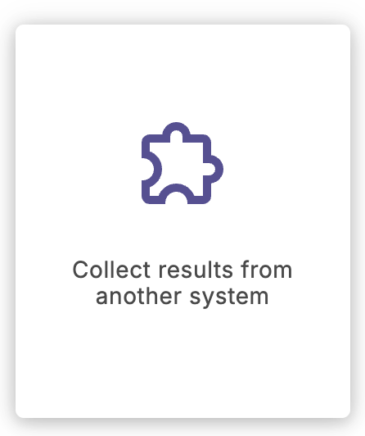
Assessment Plans: Assess Outcomes/Measures From an Integration
If you have another Watermark product that is integrated with Planning & Self-Study, data can be pulled in with this option.

Slide 31
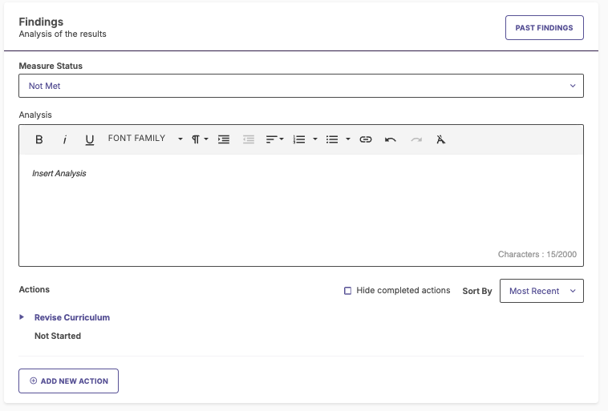
Assessment Plans: Findings for Measures
Use the data you have added to your measures to identify whether you have met the target for your measure or not.
Choose “met” or “not met” to identify the status.

Slide 32
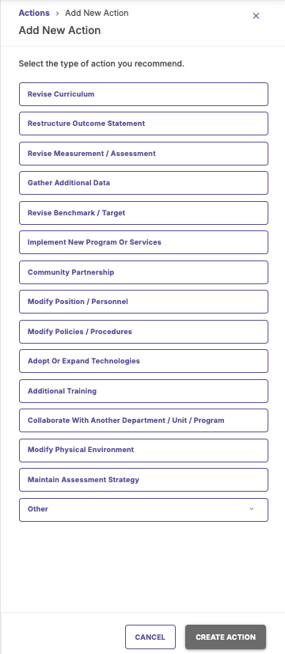

Assessment Plans: Entering Actions
Once you determine whether a measure (or outcome) is met or not met, you can assign an appropriate action at the measure or outcome level (or both)
For example, if a measure is not met, an action might be to “Revise Curriculum.”

Slide 33
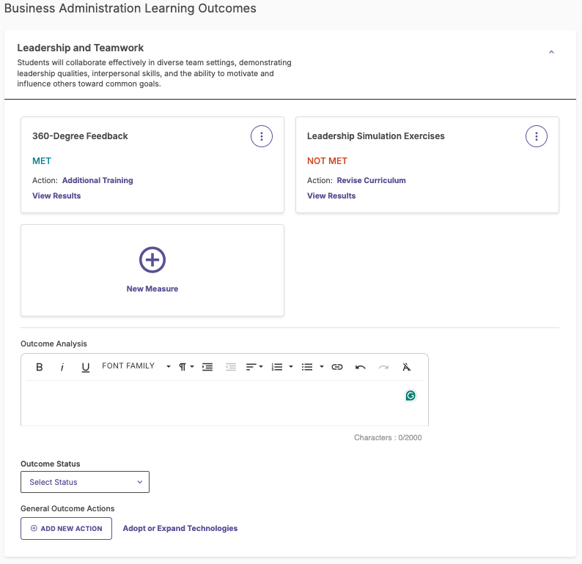
Assessment Plans: Outcome Analysis
After you have analyzed at least one measure, you can determine whether your outcome is met or not
Assessing your outcome overall will generate useful reports

Slide 34
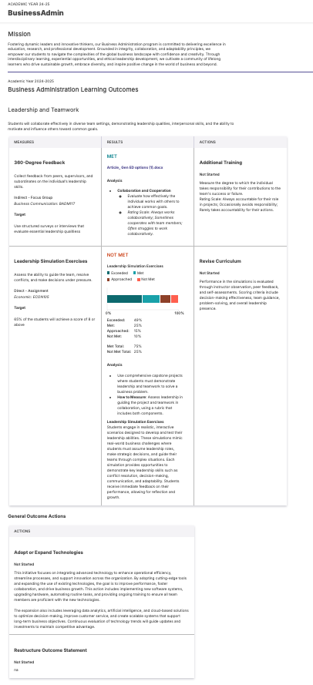


Assessment Plans: Plan PDF report
Outcomes, measures within those outcomes, actions and other data added within a Plan can be shared and downloaded on an annual Plan report in PDF format.
These reports are available for every program and organization (e.g. department) in your hierarchy individually that are included in an Assessment Plan.

Slide 35



Assessment Plans | Review process | How to Submit?
Once you have selected your Outcomes, accessed the Measures and defined Actions for your Plan you will be able to Submit your Plan for review.
Few things to note
Once you have Submitted your Plan for review:
The “EDIT” button will continue to show as an option TILL your reviewer starts to review your plan. If you click “EDIT” during this time you will need to re-submit your plan.
Once your reviewer starts to review your plan; your whole plan will be locked down till your review process is complete.
Step 1
Step 2
Step 3
Click
Review your Plan.
If you need to make a change to your plan- Click “Edit”. Once done making the edits.
Click “Review and Submit” button again.
Click

Slide 36
Questions about Plans?

Slide 37
Time to Practice!
Take the next 15 minutes to:
Enter the Plan and select the outcomes you will assess
Navigate the Plan to get familiar with the different options to add data
Feel free to reach out for questions!

Slide 38
Watermark Support
Watermark Help Center
The Help Center is managed by our Client Support Team and its knowledge base is a useful tool that displays information by Watermark product and user role. As a Watermark Administrators, you can easily search for, navigate, and learn key information that will help in your daily tasks of managing Watermark's solutions.
Knowledge articles and guidance
News & Updates/ Releases
Training Resources
Assessment Questions/Support:
Erin Paysinger
Director of Institutional Effectiveness
epaysinger@lander.edu (864)388-8569
Ticket Support:
Karen Minter
Instructional Technology Manager
kminter@lander.edu
(864)388-8234
Submit a Request:
  Click on “question mark icon” - upper right corner of P&SS to get to Help Center
Live Chat:
  Via Help Center website - lower right hand corner

